Slide 1
Additive Synthesis
Individual components (usually simple sine waves) with independent amplitude envelopes are combined to form a single complex timbre.
The basic building block of an additive synthesis instrument is an oscillator (usually oscili) and an envelope generator (usually one with multiple stages (ADSR, at least).

Slide 2
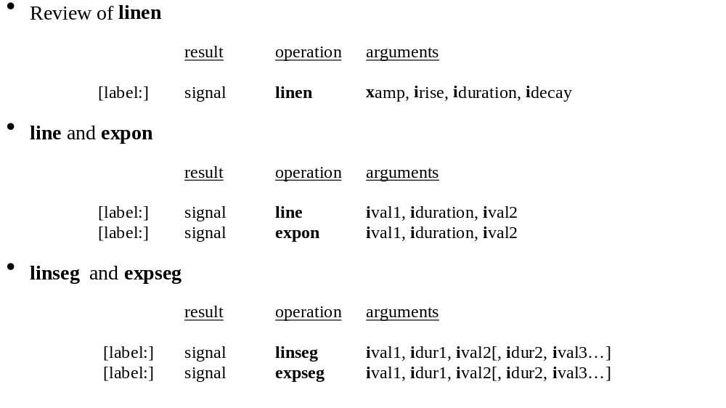
Generating Functions of Time
The basic Csound envelope generators:

Slide 3
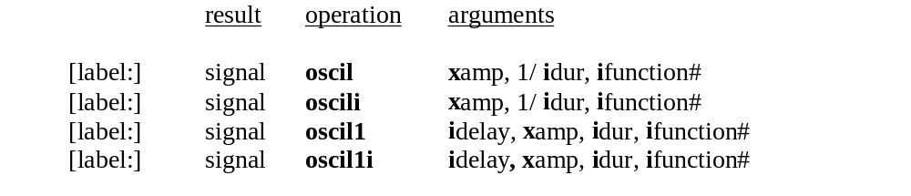
Oscil & Oscil 1 – The original envelope generators
Oscil can be used as an envelope generator by simply using 1/duration as the frequency argument. Several of the examples in the Dodge book use oscil this way.
Oscil1 has a duration argument, instead of a frequency argument. It also has a delay, and only reads through its table once.
Oscil1 outputs xamp * fn(first) during the delay; then in outputs the value xamp * fn(last) after it has reached the end of the table.

Slide 4
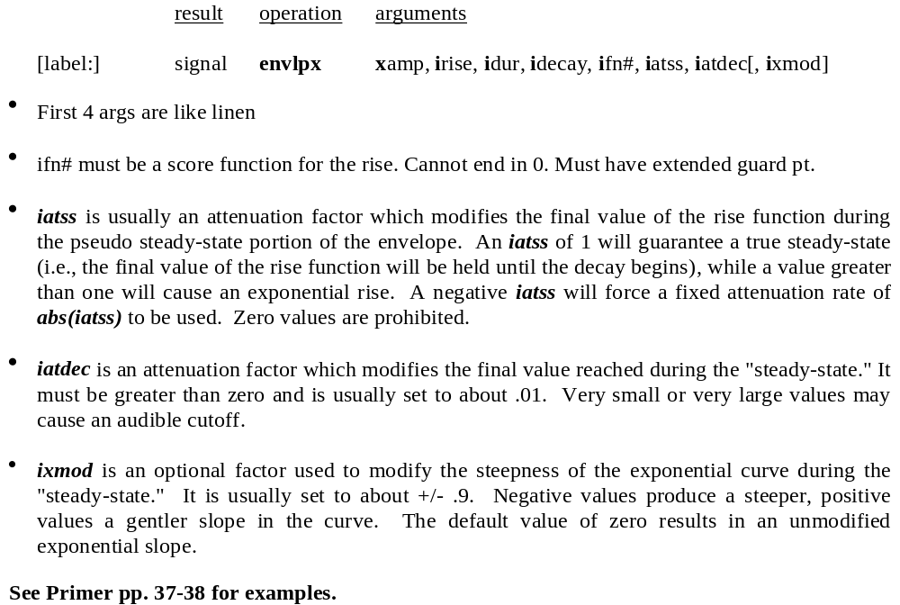
The Csound envlpx unit

Slide 5
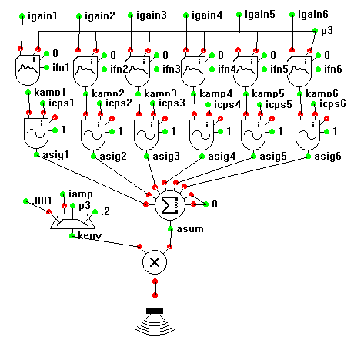
Additive Synthesis Instrument
6 oscil1i units with different gains and envelope functions
6 oscili units with different frequencies that are multiples of a fundamental frequency.
all oscili units use function 1 (sine)
all output signals are summed and then gated by an overall linear envelope.
view code

Slide 6

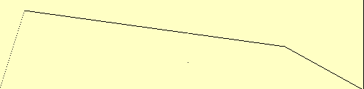




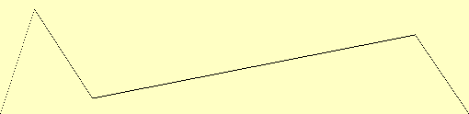
Additive Synthesis Ex. 1
Partial 1 Amp .8
Partial 3 Amp .8
Partial 4 Amp .8
Partial 5 Amp .7
Partial 7 Amp .8
Partial 8 Amp .8

Slide 7
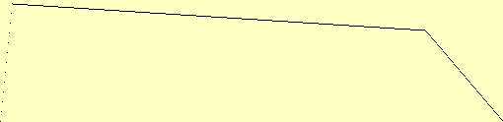
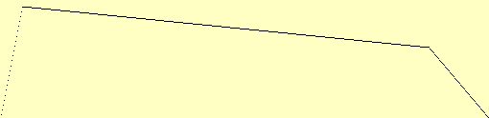




Additive Synthesis Ex. 2
Partial 1 Amp .8
Partial 2 Amp .8
Partial 4 Amp .6
Partial 8 Amp .8
Partial 16 Amp .8
Partial 32 Amp .8

Slide 8






Additive Synthesis Ex. 3
Partial 1 Amp .8
Partial 2.99 Amp .6
Partial 4.01 Amp .8
Partial 4.98 Amp .5
Partial 7.04 Amp .4
Partial 8.02 Amp .6

Slide 9
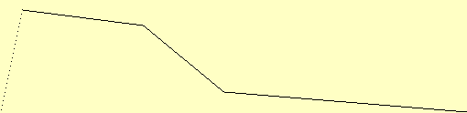

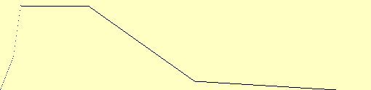



Additive Synthesis Ex. 4
Partial 1 Amp 1
Partial 2 Amp 1
Partial 3 Amp 1
Partial 4 Amp .7
Partial 5 Amp .3
Partial 7 Amp .1

Slide 10




Additive Synthesis Ex. 5
Partial 1 Amp 1
Partial 1.01 Amp 1
Partial 1.02 Amp 1
Partial 1.04 Amp 1
Partial 1.05 Amp 1
Partial 1.06 Amp 1

Slide 11
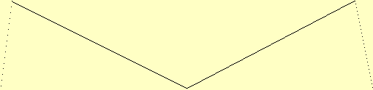
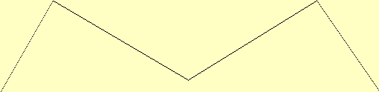




Additive Synthesis Ex. 6
Partial 1 Amp 1
Partial 1.12 Amp 1
Partial 1.26 Amp 1
Partial 1.41 Amp 1
Partial 1.59 Amp 1
Partial 1.78 Amp 1

Slide 12

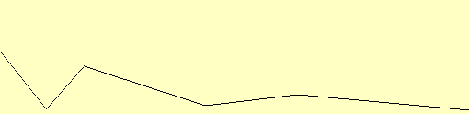
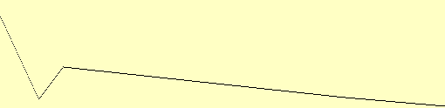
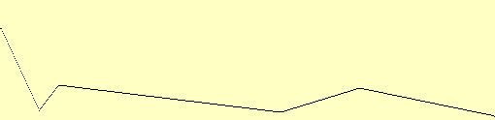
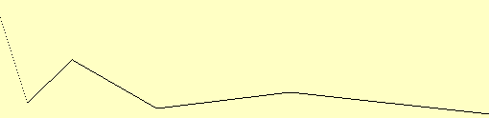
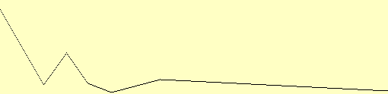
Additive Synthesis Ex. 7
Partial 1 Amp .4
Partial 1.97 Amp .45
Partial 2.8 Amp .5
Partial 4.2 Amp .6
Partial 8.24 Amp .7
Partial 13.8 Amp .7

Slide 13
The Endless Glissando
Endless2.orc, a variant of additiv.orc can generate an endless glissando effect
A psychoacoustical phenomenon:
  Glissando seems to be endless because:
    sound consists entirely of octaves (pure sine waves)
    amplitudes are related to pitch, so that only the octaves in the midrange are audible
    we identify the lowest audible pitch as fundamental
    as lowest pitches become inaudible, our ears identify a higher pitch as the fundamental
view code

Slide 14
Simple Chorus Technique
A simple chorus effect can be obtained by adding two oscillators together that are slightly detuned.
The resulting effect is called “heterodyning” – a beating that occurs that is equal to the difference in frequencies.
Formula: sin a + sin b = 2 * sin ((a+b)/2 ) * cos ((a-b)/2)
The new perceived pitch will be the average of the two sine waves’ frequencies.
The beat frequency is really only half of the difference [(a-b)/2], but we hear two beats for each cycle (one positive and one negative).

Slide 15
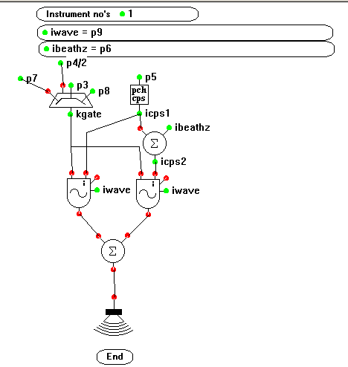
Simple Chorus Instrument
view
code

Slide 16

Csound Debugging Opcodes
Use print to display a list of initial values (variables or expressions that are valid at i-time).
Use display to show values of changing signals (k or a-type variables) over time.
E.g.
kenv linen 10000,.5,p3,.75
display kenv, p3

